Slide 1

NI
Lecture
Networking Infrastructure
Introduction to NI
Structured Cabling
1
Networking Infrastructure
Diploma in CSF / IT
Year 2 (2022/2023), Semester 3
Notes:
Left-hand Bar – Replace FSP by your module code and X by the lecture number.
Replace Lecture Title
Replace < Module Name >
Replace Year and Semester if necessary

Slide 2
Objectives
Recap Networking Fundamentals in OSNF module
Structured Cabling

Slide 3


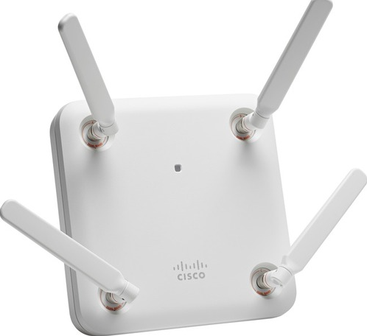
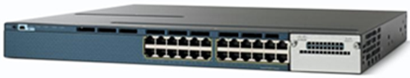
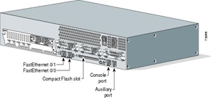

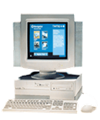
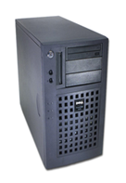
A Typical Network Infrastructure
Wireless LAN
LAN
WAN
Wireless
Access
Point
Laptop
Switch
Router
Server
Desktop

Slide 4
A Quick Refresh
Network Classification
Networks are classified according to the geographical area over which they extend
LAN, WAN
Network Topologies
A physical network topology refers to the cabling layout used to link devices.
Star, Bus, Ring, Meshed

Slide 5
Logical and Physical Addresses
Each protocol may use a different type of address to direct a message to the correct process on the intended destination device.
These addresses fall into two general categories:
Physical address
Logical address

Slide 6
Logical and Physical Addresses
Physical Address
Logical Address
Physical address is a unique identifier hard-coded into the NIC.
Comprises 48 bits or 12 Hex digits e.g. 00-40-96-51-4F-55
Its other common names are:
Medium Access Control (MAC) address
NIC or Adapter address
Hardware address
Ethernet address
Logical address is assigned by software e.g.
IP address: 153.20.57.31
Port addresses:
TCP Port number : Port 80 for HTTP
UDP Port number : Port 53 for DNS

Slide 7
Layers of Addresses
Physical and logical addresses work together to transmit information from source to destination in a network.
Each layer uses the service of the layer below it and provides services to the layer above. The TCP/IP model describes a protocol stack that consists of four layers of services and protocols.
The four layers are:
Application
Transport
Internet
Network Interface

Slide 8
TCP/IP Protocol Stack
It defines …
Protocol Layer
Application
HTTP, SMTP, DNS, FTP etc.
TCP, UDP etc.
Transport
Internet
IP (IP Addressing)
Network Interface
Data Link e.g MAC
Physical e.g. PHY
Ethernet, Wireless LAN
Transmission Medium (e.g. UTP, Optical Fibre, Wireless)
Notes:
Note:
Transmission Medium is not part of TCP/IP Protocol Suite
Network Interface is subdivided into Data Link and Physical Layer resulting in a 5-layer instead of the original 4-layer model

Slide 9

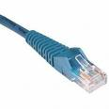


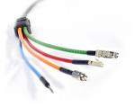
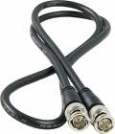

Transmission Media & Network Cables
Network cable is made of transmission medium with connectors at its ends
The three common type of network cables are:
Medium Network Cable
Twisted Pair
Optical Fibre
Coaxial Cable
Notes:
Optical Fibre is also known as Fibre Optics

Slide 10
Activity – Recap on OSNF module
Complete Activity 1 of Session 1 Activity document

Slide 11
Structured Cabling Standards
TIA – Telecommunications Industry Association
EIA – Electronic Industries Alliance
These are trade associations that jointly develop and publish a series of standards covering areas of structured voice and data wiring for LANs.

Slide 12
TIA/EIA Structured Cabling
This refers to the installation of cables in a building or a campus following a standardized manner.
The resulting cabling infrastructure can be divided into Subsystems.
Entrance Facility / Building Entrance contains the Demarcation Point where the telecom provider network ends and connects with the on-premises wiring belonging to the customer.
Equipment Room is a large telecommunication room that may house more sophisticated equipment such as network servers, routers, switches, etc.
Telecommunication Room where patch panels are used for connecting between backbone cabling and horizontal cabling; it may house networking equipment such as switches and routers.
Backbone Cabling / Vertical Cabling connects between the telecommunication rooms and equipment room, typically on different floors.
Horizontal Cabling connects patch panel in the telecommunication room to individual outlets or work areas on the floor, usually through the wireways, conduits or ceiling spaces of each floor.
Work Area Components connect end-user equipment (e.g. computers) to outlets of the horizontal cabling system. Ref: http://en.wikipedia.org/wiki/Structured_cabling

Slide 13
Activity - Structured Cabling Video
Refer to the previous slide as you watch the video
https://www.youtube.com/watch?v=NRE6O_mvFus

Slide 14
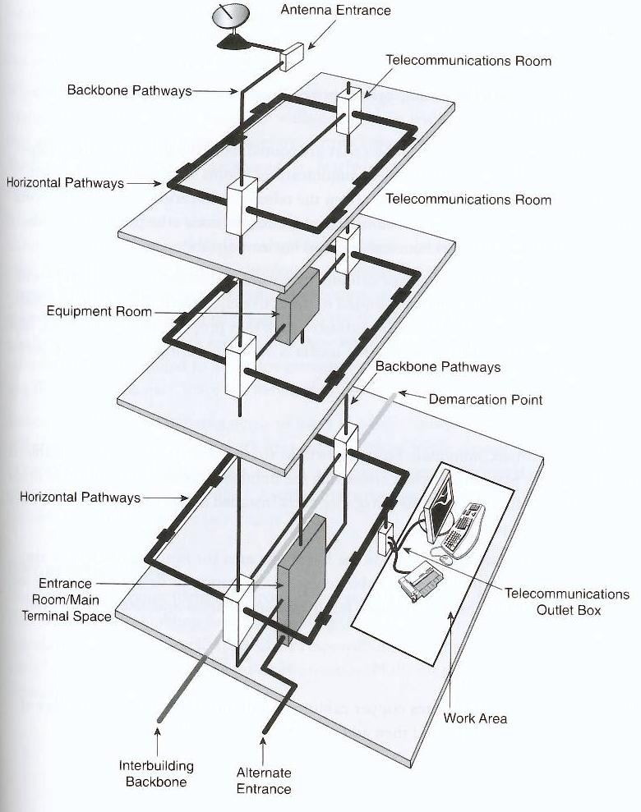
Subsystems of Structured Cabling

Slide 15
1. Entrance Facility / Demarc
Demarc
Notes:
Demarcation Point is within the entrance facility.

Slide 16
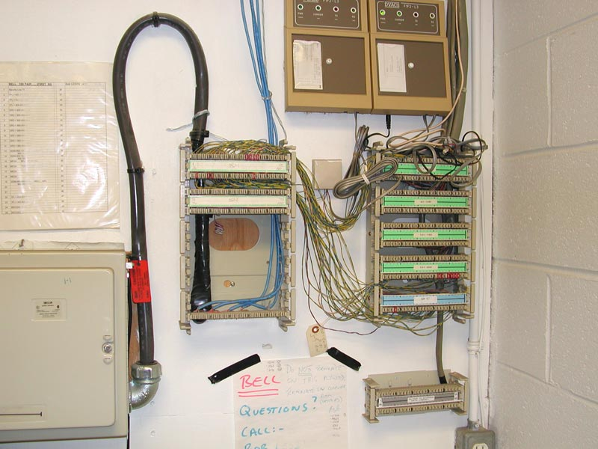
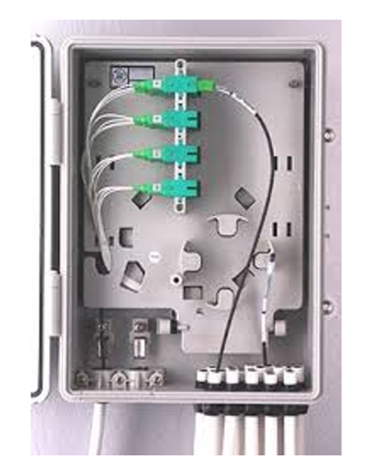
1. Entrance Facility / Demarc
It contains the demarcation point at which outdoor cabling interfaces with the on-premise backbone cabling
Represents the boundary between telecom provider’s responsibility and that of the customer
Notes:
Demarcation Point is within the entrance facility.
The boundary between Telco provider’s responsibility and the customer’s responsibility
Connects outdoor cabling to the on-premise wiring / backbone cabling

Slide 17
2. Equipment Room
ER

Slide 18
2. Equipment Room
An equipment room (ER) is a room or space within a building for the installation of mechanical or electrical/electronic devices.
Centre for voice and data network
Servers, network equipment and patch panels may be mounted to a wiring closet, rack or cabinet
An equipment room is considered distinct from a telecommunication room because it is considered to be a building or campus serving (as opposed to floor serving) facility and because of the nature or complexity of the equipment that it contains.
Notes:
Room in building dedicated for mechanical/electrical devices
Also, the center for voice and data network
Equipment such as servers switches and routers are stored in it using wiring closet, rack or cabinet
Distinct from TR because if is campus/building serving and can because of the nature or complexity of the equipment stored in it.

Slide 19
3. Telecommunication Room
TRs

Slide 20
3. Telecommunication Room
In larger facilities, ER may feed one or more telecommunication rooms (TRs)
TRs are where connections take place to provide a transition between the backbone cabling and horizontal cabling
A TR houses the terminations of horizontal and backbone cables to connecting hardware such as patch panels and cross-connects, patch cords and jumpers.
Notes:
May have more than 1 TR
TRs are where connections takes place to serve as a transition between horizontal and backbone cabling.
Houses the terminations of horizontal and backbone cabling to connecting hardware such as patch panels.

Slide 21
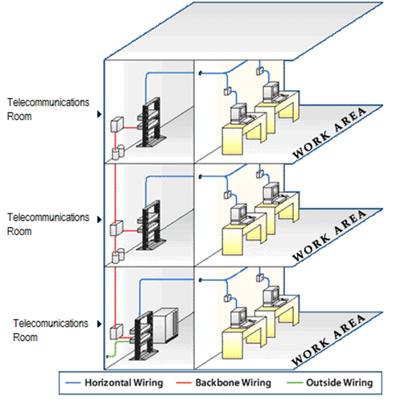
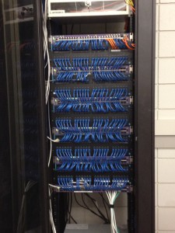
3. Telecommunication Room
Telecommunication Room may house equipment such as:
Wiring closets
Switches
Routers
Wiring closet
Ref: http://www.jumpnetworks.net/services.php

Slide 22
Structured Cabling – Wiring Closet , Backbone & Horizontal Cabling Example
Equipment and patch panels mounted on the wiring closet
Backbone Cabling (optical fibre)
Switches
on the rack
Backbone
Patch Panel
Horizontal
Patch Panel
Horizontal Cabling (UTP)

Slide 23
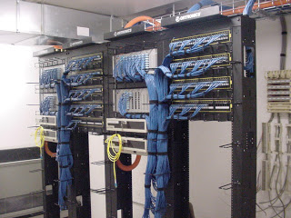
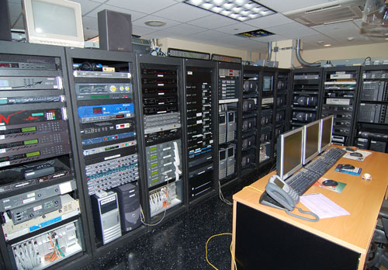
TR Vs ER

Slide 24
4. Backbone / Vertical Cabling
Backbone
Cabling

Slide 25
4. Backbone / Vertical Cabling
Any cabling between the ER and another TR throughout the facility, includes:
TRs on same floor
Backbone connection (risers) between TRs on different floors
Inter-buildings cabling in a multi-building campus
Usually fiber optic cables
Accommodate future growth or scalability by planning ahead when estimating the number of cable runs (number of cables)
To determine how much extra, first determine the number of runs needed now, and then add some extra, about 20%
Notes:
Fiber optical cables
For future growth, need 120% of cable required.

Slide 26
5. Horizontal Cabling
Horizontal
Cabling

Slide 27
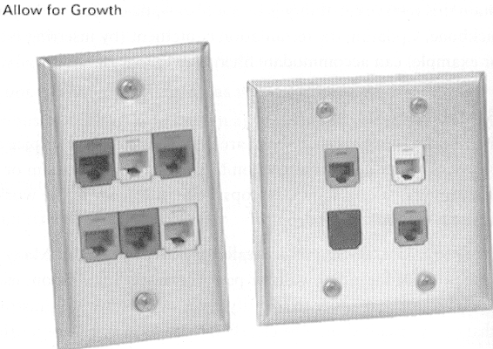
5. Horizontal Cabling
Distributes cables from the TR to the work areas
Usually UTP cables
Accommodate future growth or scalability by planning ahead when estimating the number of cable runs
Common practice to pull extra cable to each workstation or desktop for future use, i.e. provides for expansion
Notes:
UTP Cables
To accommodate future growth, pull one extra cable to each workstation for future use

Slide 28
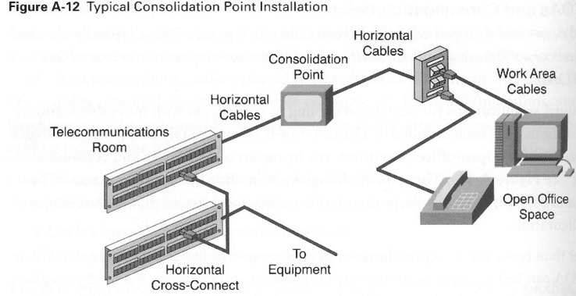
5. Horizontal Cabling
Faceplate/
Wall Outlet
90m max
Patch Panels
5m patch cords, usually UTP cable
Notes:
Consolidation Point (optional) – located close to open office area to prevent the need to replace the cable all the way back to the TR.
In School of ICT, there is only one patch panel instead of two patch panels for Horizontal Cross-Connect.

Slide 29
6. Work Area
Work
Area

Slide 30
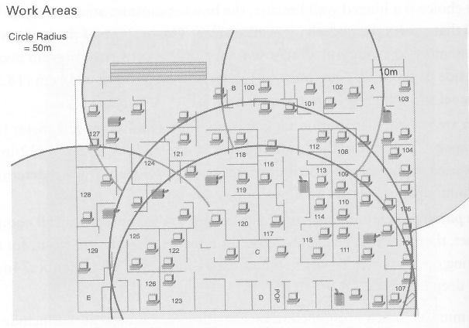
6. Work Area
Area serviced by an individual TR
Usually occupies one floor or part of one floor of a building

Slide 31
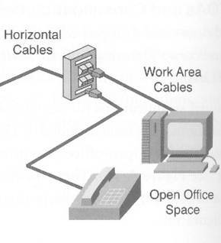
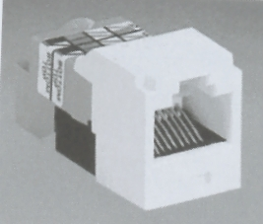
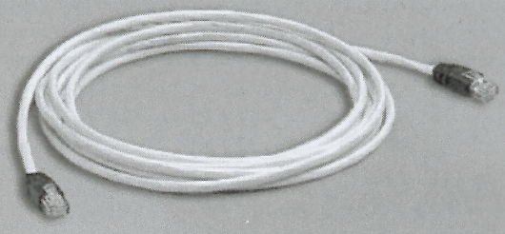
Servicing the Work Area
A uniform wiring plan must be used throughout a patch panel system
Information/Wall outlet
RJ-45 sockets most common
UTP Patch cords
- RJ-45 plugs

Slide 32
Summary
Recap of networking fundamental concepts
Structured Cabling System
1. Entrance Facility
2. Equipment Room
3. Telecommunication Room
4. Backbone cabling
5. Horizontal cabling
6. Work Area

Slide 33
Activity – ICT Network Tour
Complete Activity 2 of Session 1 Activity document

